Slide 1

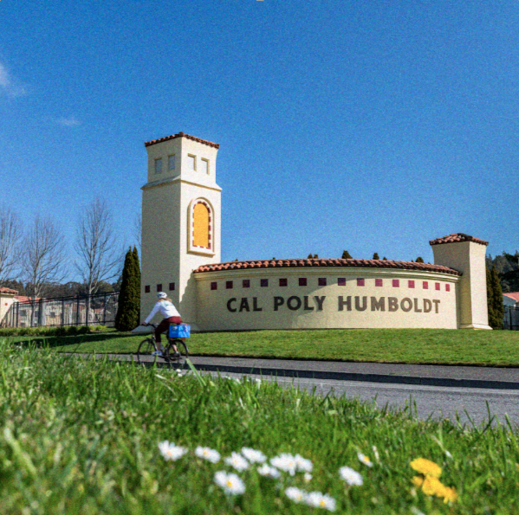
Intro to JupyterHub on the National Research Platform
Presented by Cal Poly Humboldt - ITS
Brian Campbell - Academic Technology Specialist
Ravi Chalasani - ITS Research Support Technician
Library 308 - 6/26/2025

Slide 2

National Research Platform What is the National Research Platform?
Free to access subject to accepting Acceptable Use Policy
Collection of computing resources housed under one umbrella
Funded by NSF
Grew out of the former Pacific Research Platform
Distributed network of over 400 servers with massive computing power - https://dash.nrp-nautilus.io/
More computing power compared to running locally
Instantly scalable to higher workloads

Slide 3

National Research Platform
Do Not Mine crypto on NSF funded machines
federal crime
Violators will get caught
Violators will be reported to the FBI
Cluster users may not use the computers to enrich themselves financially
Faculty/PIs: Please share this with your students

Slide 4

Accessing NRP Nautilus Portal
URL for NRP Nautilus Portal: https://nrp.ai/viz/resources/
We use the portal to create Namespaces for your projects
We can add you and your students to your Namespace
You can check for available resources
NRP access is provided via Cyber Infrastructure CILogon and Authentik

Slide 5
NRP Support on Campus
Our process:
Initial consultation about your project
Team based help with accessing NRP
Uploading any preexisting code/Notebooks to JupyterHub
Troubleshooting, custom packages for specific needs
e.g. Otter-grader
Uploading/downloading data to/from NRP
Collaborate to adapt and improve processes
Continued consultation until your project is successful

Slide 6
How to Contact Us
SBS 413 (by appointment)
Email: itsresearchsupport@humboldt.edu
Create a HelpDesk ticket
Website: https://its.humboldt.edu/research/high-performance-computing
Phone: x4100

Slide 7
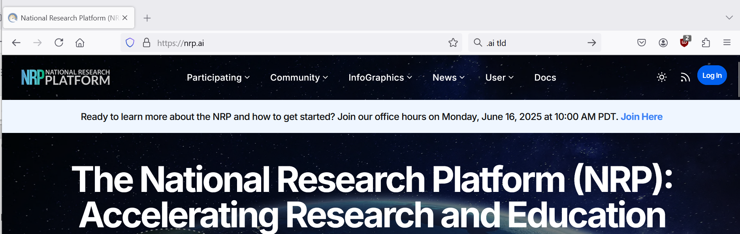
NRP Portal Pre-Login Screen

Slide 8
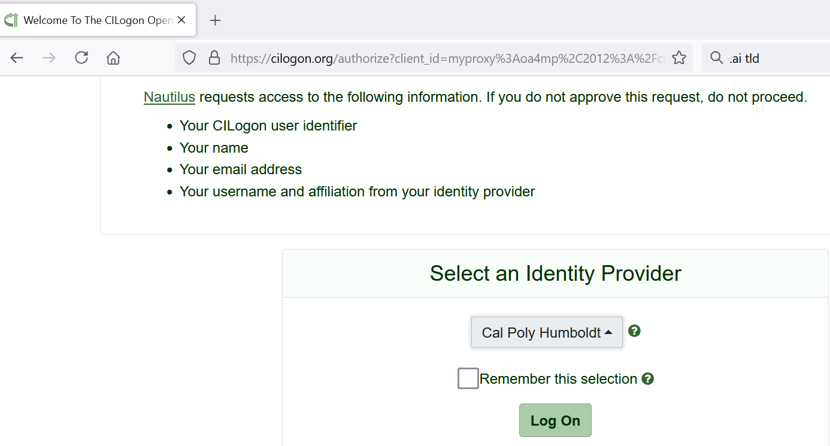
NRP Portal CILogon Screen

Slide 9
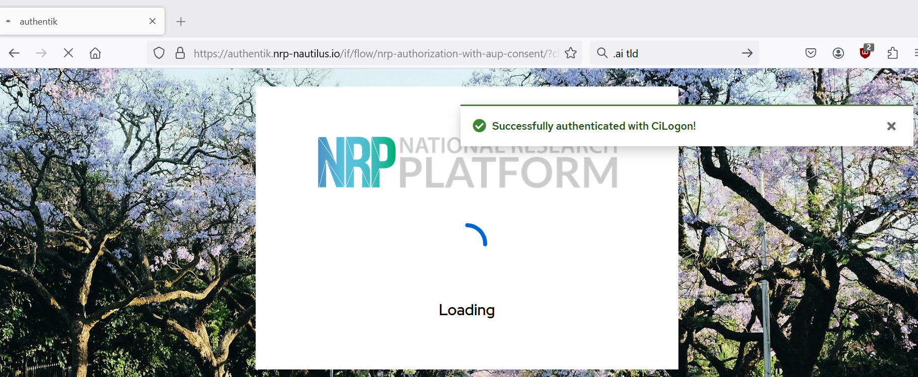
NRP Portal Authentik Screen

Slide 10
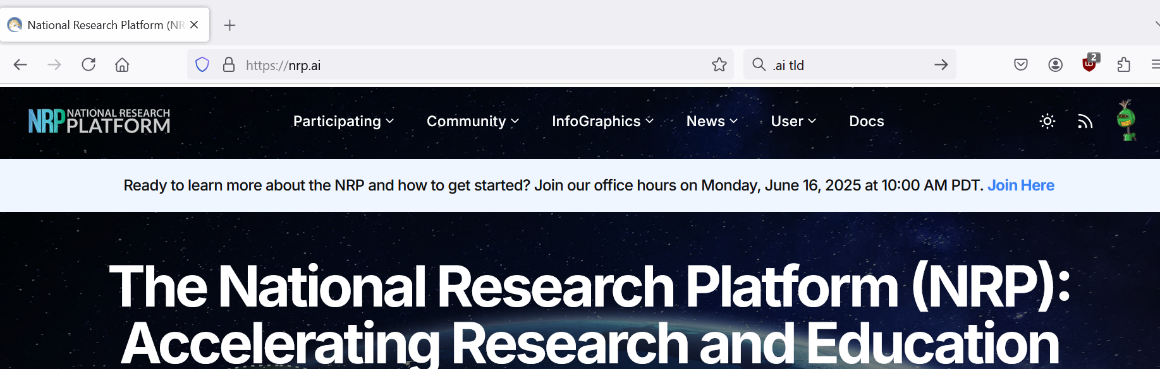
NRP Portal Logged-in Screen

Slide 11
Jupyter… Hub, Notebook, etc
JupyterLab: Local development environment for Jupyter Notebooks, allowing for markdown and code execution in “cells”
It is not a programming language, it supports other languages
JupyterHub (JH): Allows for execution of Jupyter Notebooks on a remote server
Instantly transferable from local computer to high-performance computing resources
Your data is stored in a 5GB Persistent Volume Claim (PVC)
Code will keep running as long as your browser tab is open to JH
Idle JH sessions will be terminated by NRP however your PVC data is preserved

Slide 12


Local vs. NRP (with GPUs)
def batched_dot_mul_sum(a, b): '''Computes batched dot by multiplying and summing''' return a.mul(b).sum(-1)
2.879 s
0.000259 s

Slide 13

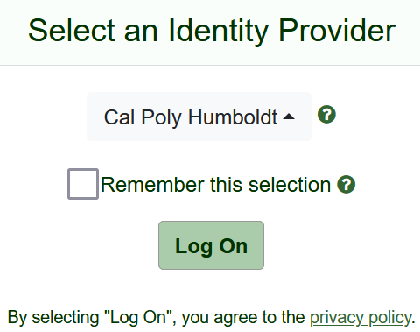
How Do I Access JupyterHub?
https://jupyterhub-west.nrp-nautilus.io/
https://github.com/cal-poly-humboldt/NRP-Tutorials
Use CyberInfrastructure Logon (CILogon)
Use Humboldt login

Slide 14
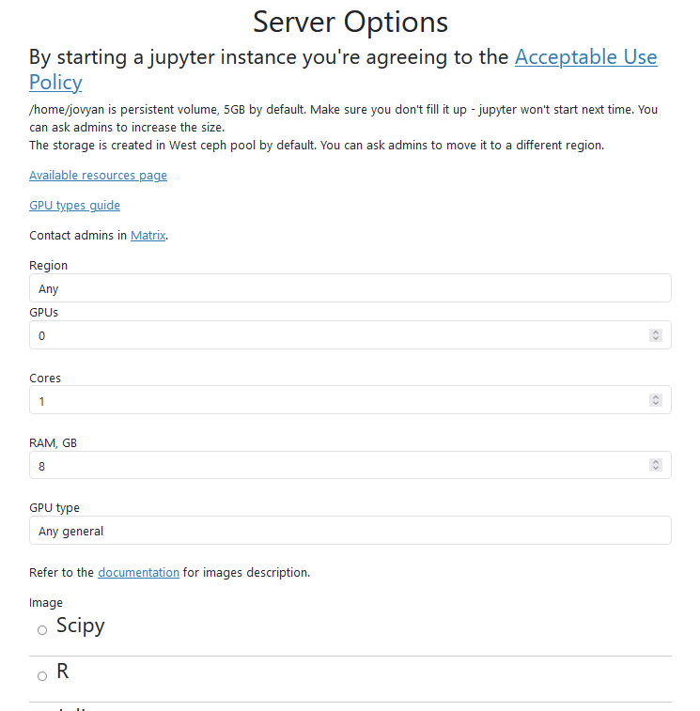
JupyterHub Options
Select Region if desired
GPU if needed
Graphics Processing Unit
additional brain for graphics
can be adapted for other compute
Select CPUs called cores
Central Processing Unit
It’s the brain of the computer
That’s where the math is done

Slide 15
JupyterHub Options
Select RAM
Random Access Memory
RAM larger than file size if possible
Select Image (environment)
If don’t know use default
Unless you are programming in R, then select R

Slide 16
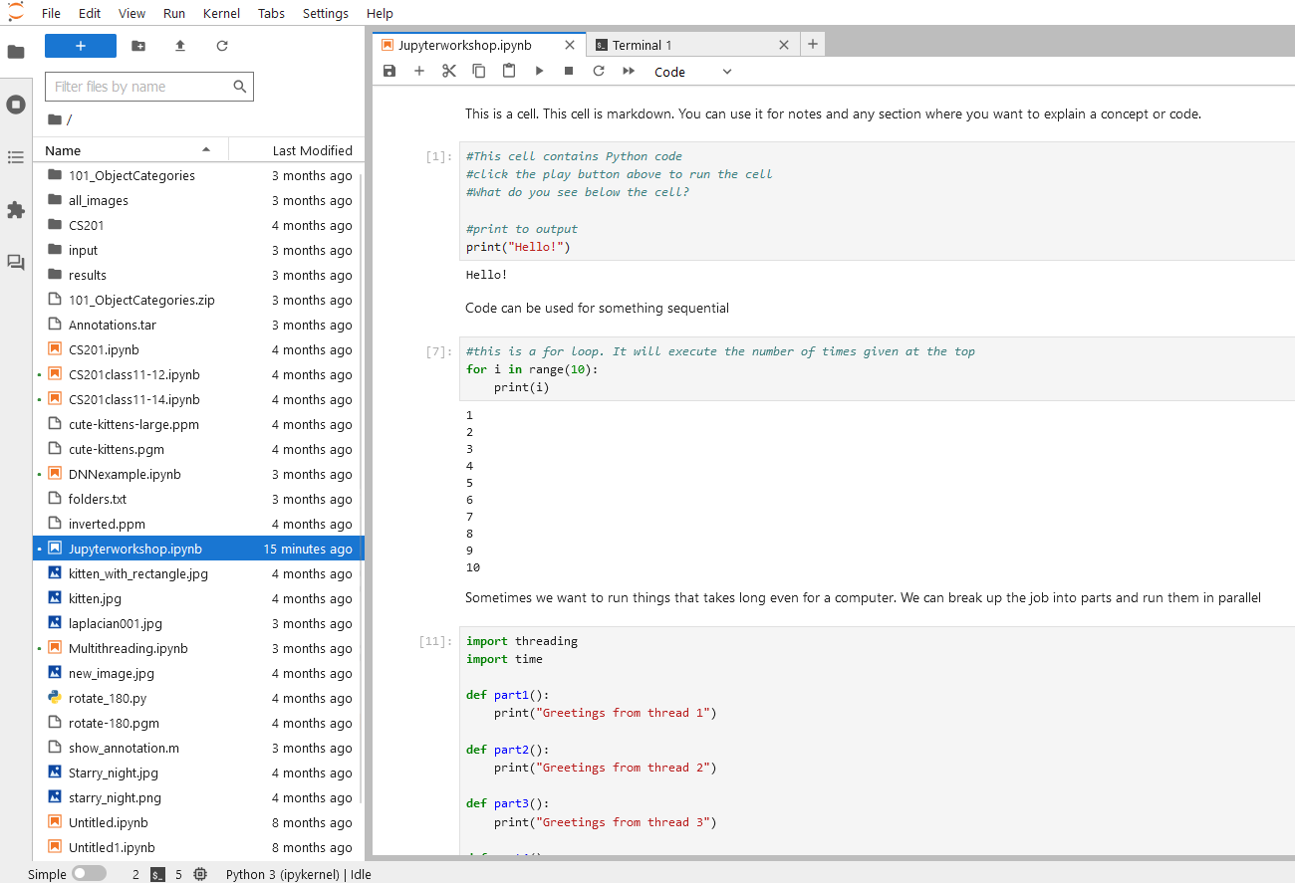
JupyterHub Interface
Graphical User Interface (GUI):
File system explorer on the left
Notebooks etc. on the right

Slide 17
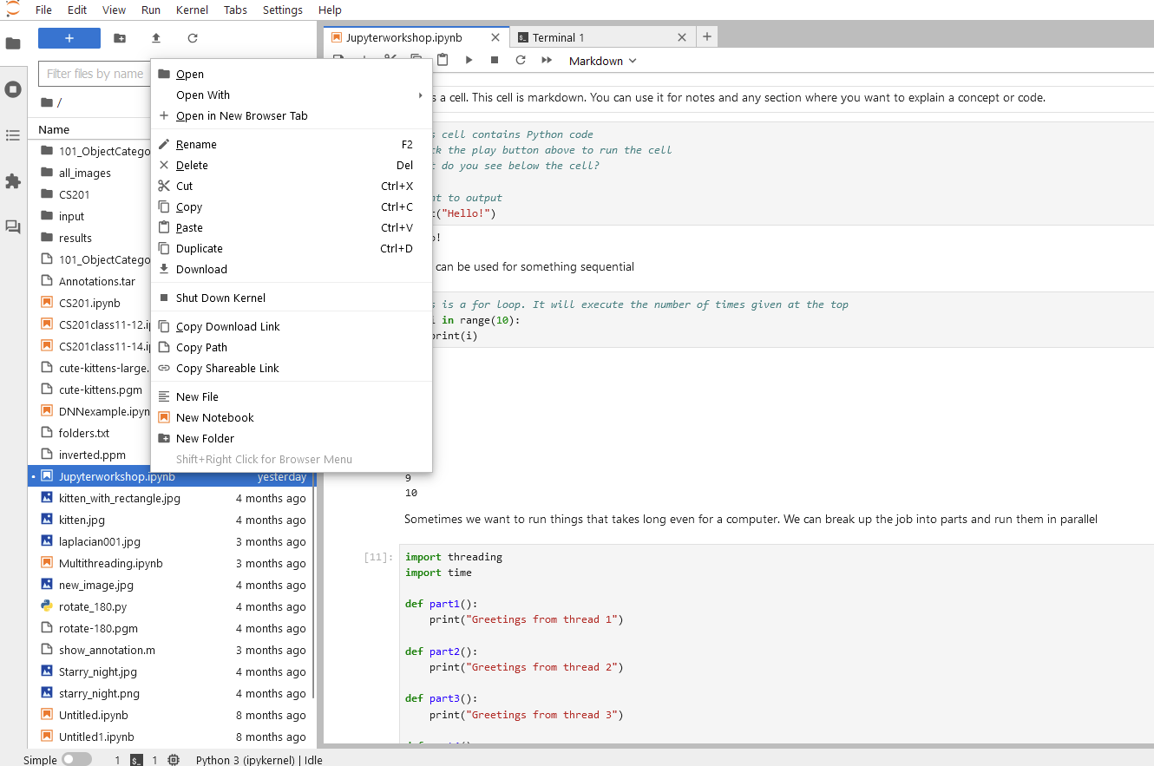
JupyterHub Interface
File System:
upload files
download files
R-click the file
select Download

Slide 18
JupyterHub Interface
Notebook:
Cells
Markdown for notes
Code for Python or R
Output areas after the code runs
Pick which cells to run

Slide 19
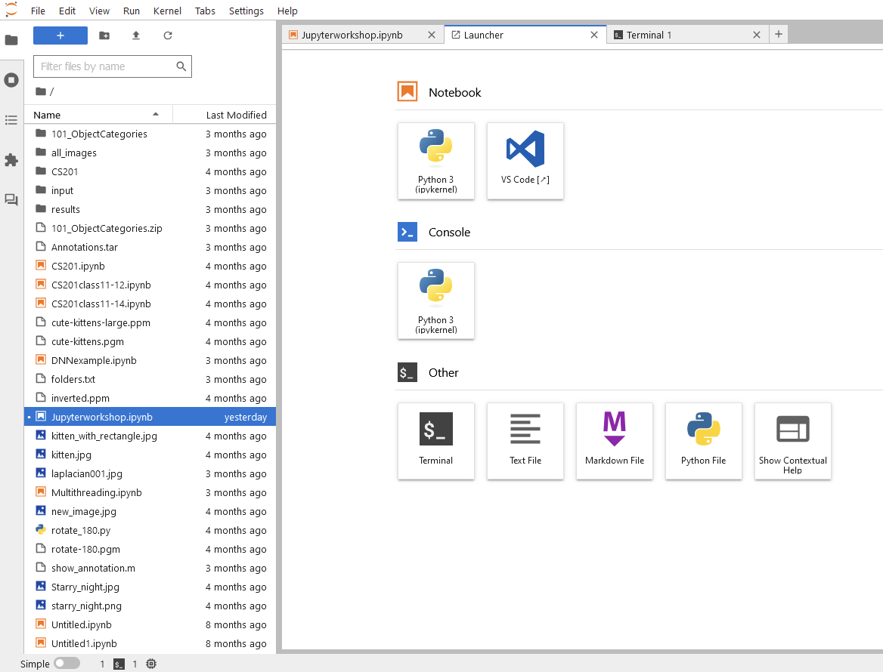
JupyterHub Interface
Click the + to use the Launcher
Open a New Tab
New Notebook File
Terminal Windows

Slide 20
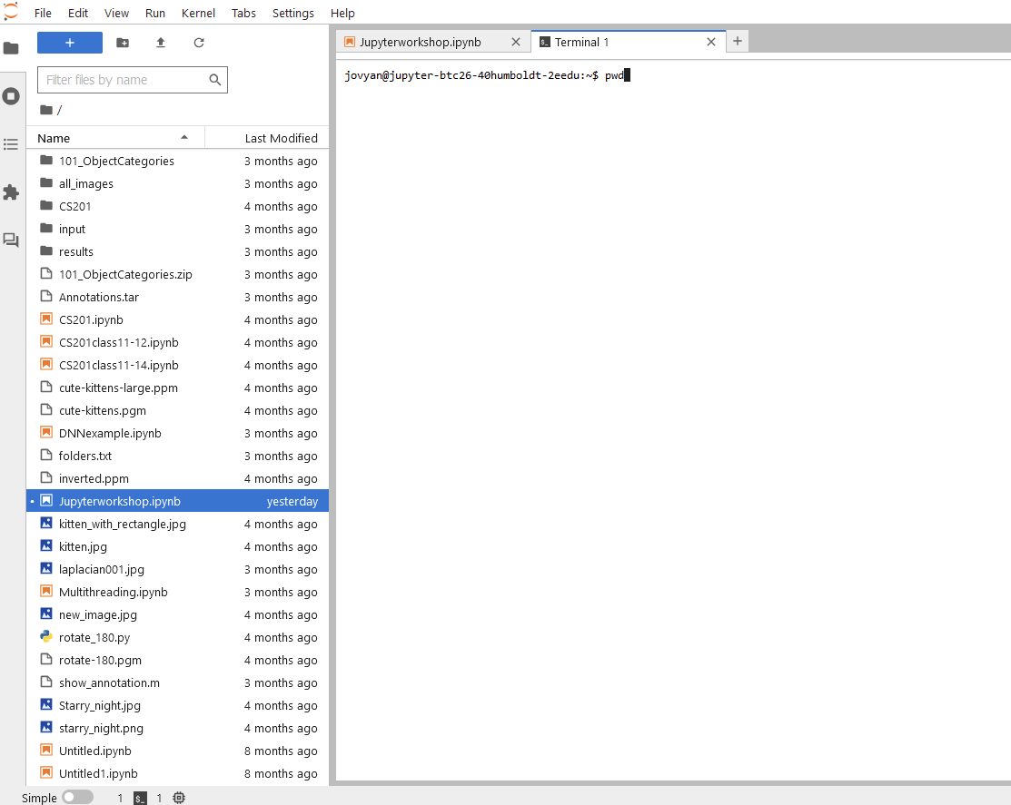
JupyterHub Interface
Terminal:
Linux Command Line Interface
Usually optional
can use to install additional packages
Allows for installations
Command to try:
pwd

Slide 21
Interactive demo of JH

Slide 22
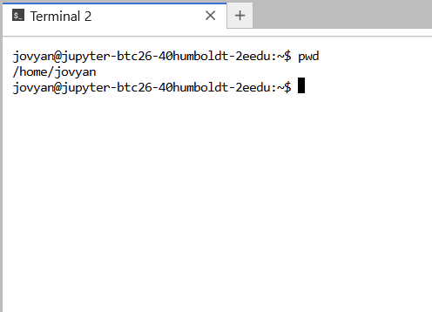
JupyterHub Environment: Linux Terminal
Full Linux terminal
run commands
ex: pwd

Slide 23
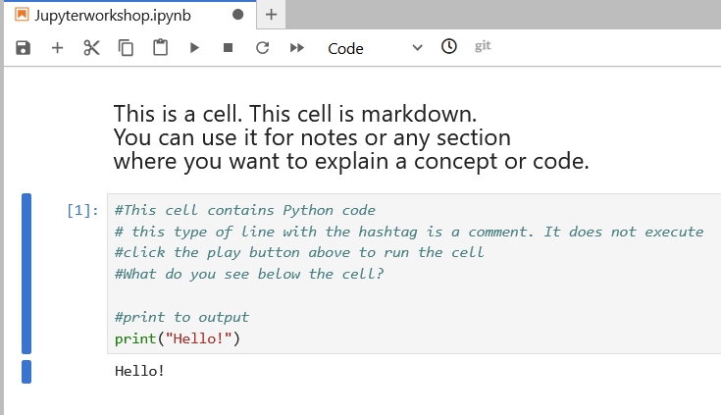

JupyterHub Environment: Notebook
markdown
code
output

Slide 24
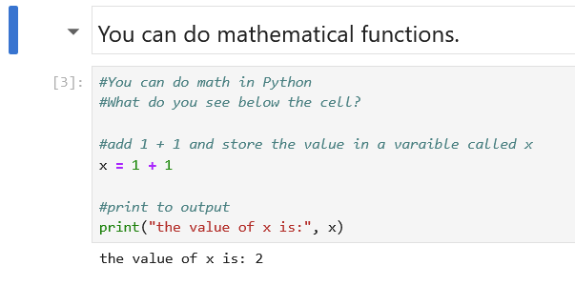
Python Basics: Math

Slide 25
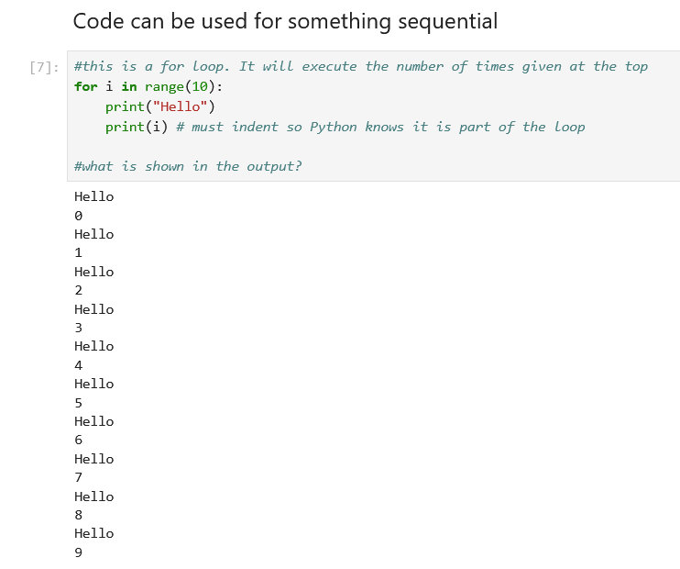
Python Basics: Looping

Slide 26
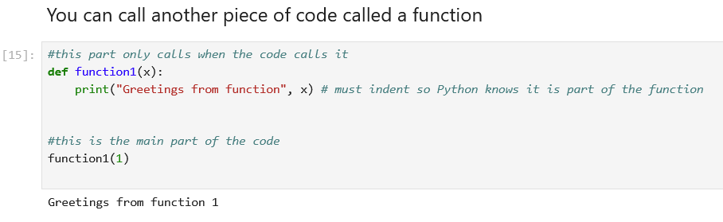
Python Basics: Functions

Slide 27
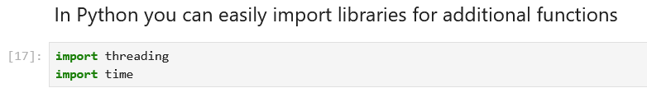
Python Basics: Libraries

Slide 28
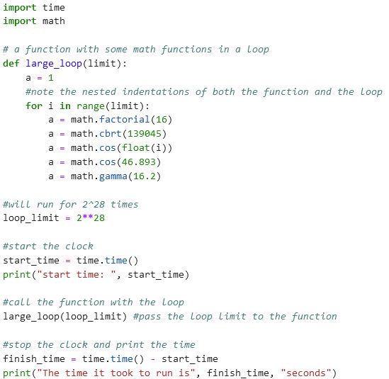
Stress the CPU: Some Math in Serial

Slide 29
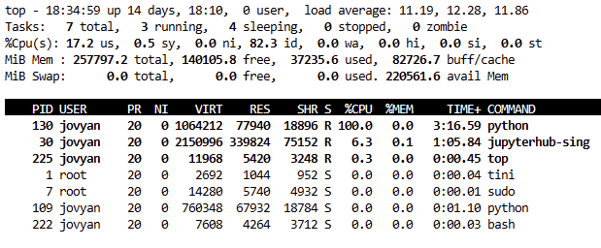
Stress the CPU: Some Math in Serial
Running 1 CPU only

Slide 30
Stress the CPU: Some Math in Serial
198 seconds for 1 CPU

Slide 31
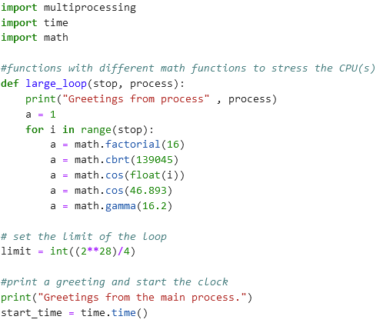
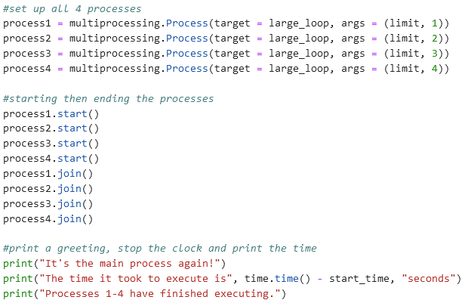
Multiprocessing
4 processes
start
stop
break up the code into 4 parts and run in parallel

Slide 32
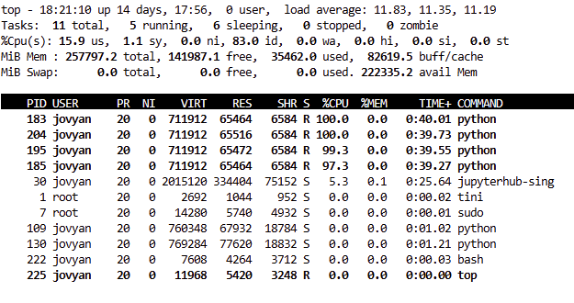
Multiprocessing
Running 4 CPUs simultaneously

Slide 33
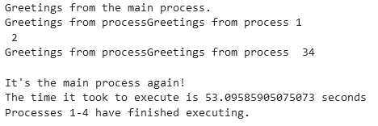
Multiprocessing
About ¼ the time

Slide 34
NRP Beyond JupyterHub
Margarete Walden Fisheries Simulation
Laptop - runtime is hours
Jupyter - runtime a few minutes
Kubernetes - increase parameters, automation, multiple parallel runs
Python automated Kubernetes - further increased automation, expanded scope of research

Slide 35
How to Contact Us
SBS 413 (by appointment)
Email: itsresearchsupport@humboldt.edu
Create a HelpDesk ticket
Website: https://its.humboldt.edu/research/high-performance-computing
Phone: x4100

